Slide 1


Budget wise AI Based expense forecasting tool
ADITYA RAJ

Slide 2


Project AI-Based Expense Forecasting Tool
A smart tool that tracks user expenses , categorizes them ,and forecasts future spending patterns using AI/ML for models. It helps individuals and businesses manage budgets effectively, predict overspending, and provide actionable insights.

Slide 3
Problem Statement
Why we need this tool.
People overspend without realizing , leading to poor financial control.
Manual budgeting → time-consuming & error-prone.
Future spending is hard to estimate without proper data analysis or forecasting tools.
Existing tools often show past data but don’t predict future expenses or alert users before overspending.
Many users find it difficult to set and track budgets dynamically as their financial habits change.

Slide 4
Why AI for Expense Forecasting?
Learns spending habits --- AI models analyze user behavior and identify unique spending patterns over time.
Predicts future expenses --- Uses machine learning and time-series forecasting to estimate upcoming expenditures accurately.
Gives real-time budget alerts --- Notifies users when they’re likely to exceed budget limits based on predictive analysis.
Personalized financial insights --- Generates customized recommendations tailored to each user’s lifestyle and goals.
Adapts to user behavior --- Continuously improves predictions as it learns from new transaction data.

Slide 5
Real-Life Use Cases
Personal Finance Management:
Individuals can track daily expenses, monitor spending patterns, and get forecasts to avoid overspending.
Household Budgeting:
Families can collectively track shared expenses and forecast monthly spending trends.
Travel & Event Planning:
Predicts total trip/event expenses based on past similar activities and provides cost-saving suggestions.
Expense Optimization for Students or Employees:
Helps individuals on fixed stipends or salaries plan expenses and save more efficiently.

Slide 6
Project Scope
The tool will provide budget alerts and personalized insights to help users make informed financial decisions.
The scope covers data preprocessing, model training, forecasting, and visualization, all implemented in Python.
The project aims to develop an AI-powered expense tracking and forecasting system for individuals and small businesses.
The system will analyze user transaction data, categorize expenses automatically, and predict future spending patterns using AI/ML models.
The project focuses on monthly and category-wise expense forecasting to assist in better financial planning.

Slide 7
Feature Engineering
Month, Weekday, and Seasonality:
Extracts date-based features (month, week, weekday, weekend flag) to capture periodic spending behavior.
Cumulative Spending Patterns:
Calculates running totals and moving averages to understand gradual spending trends over time.
Category Grouping:
Groups expenses by categories such as Food, Travel, Shopping, Bills, etc., to analyze and forecast category-specific trends.
Budget Deviation Feature:
Measures difference between actual and budgeted spending to improve forecasting feedback.

Slide 8
Time Series Forecasting
Historical Data Analysis:
Uses past expense data (daily, weekly, or monthly) to identify spending trends and seasonal patterns.
Model-Based Predictions:
Employs time series models like ARIMA, SARIMAX, or Facebook Prophet to forecast future expenses.
Trend and Seasonality Detection:
Captures recurring patterns such as weekend spikes, month-end bills, or festive season overspending
Future Expense Estimation:
Predicts short-term (weekly) and long-term (monthly) spending to aid proactive financial planning.

Slide 9
Prophet Model
Handles Holidays & Seasonality Well:
Prophet automatically models yearly, weekly, and daily seasonality, and allows adding custom holiday effects.
Simple & Intuitive API:
Easy to implement with minimal code — ideal for rapid experimentation and prototyping.
Fast & Efficient Results:
Trains quickly even on large datasets, providing reliable forecasts in seconds.
Robust to Missing Data & Outliers:
Performs well even when transaction records are incomplete or have irregular gaps.

Slide 10
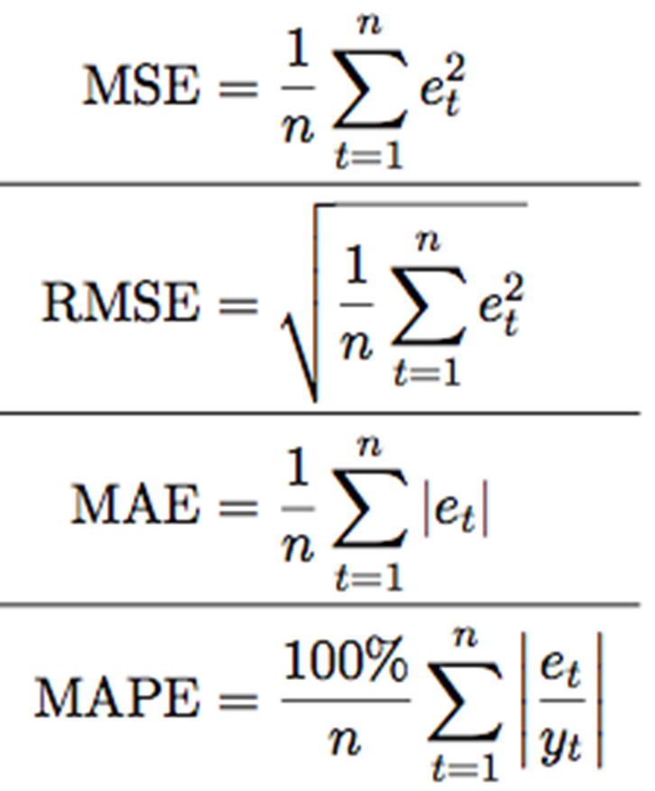
Model Evaluation Metrics
Mean Absolute Error (MAE)
Mean Squared Error (MSE)
Root Mean Squared Error (RMSE)
Mean Absolute Percentage Error (MAPE)
R² Score (Coefficient of Determination)

Slide 11
Forecast Demo

Slide 12
RNNs & LSTMs

Slide 13
Building an LSTM Model

Slide 14
Comparing Models

Slide 15
Anomaly Detection

Slide 16
Application Layer

Slide 17
Dashboard Overview

Slide 18
Visualization Tools

Slide 19
Budget Alerts

Slide 20
API Integration

